Slide 1

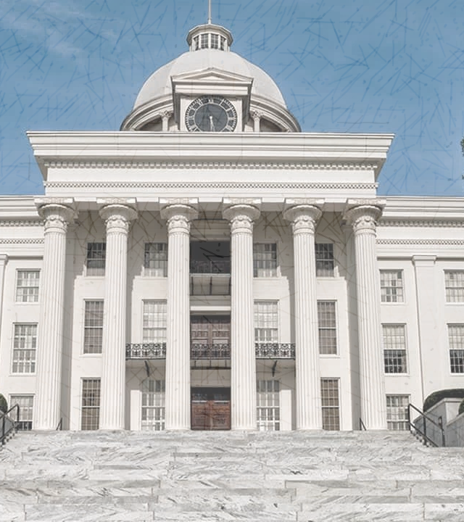
Alabama’s Budget and Finances
June 2023

Slide 2

State Budget Process
  September – Process begins with revenue estimating
  November 1st – Agencies begin submitting budget requests
          Executive Budget Office staff receive and analyze requests
  November/December – Meetings with agencies to discuss their budget requests and discussion of priorities with Governor Ivey and formulating early drafts of the budgets
          Follow up meetings with agencies as necessary
          Governor Ivey meets with legislative leadership for input on policy matters
          Budgets are finalized and prepared in the last week before the Regular Sessions begins

Slide 3
*2023 is as of April 2023

Slide 4
Rainy Day, Reserve, and Other ETF Accounts
ETF Rainy Day
 | Balance: | $585,217,649
ETF Budget Stabilization Fund
 | Balance: | $574,000,000
ETF Advancement and Technology Fund
 | Balance: | $750,000,000
ETF Educational Opportunities Reserve Fund
 | Balance: | $353,975,000
SGF Rainy Day
 | Balance: | $291,592,824
SGF Budget Reserve Fund
 | Balance: | $150,000,000

Slide 8
Education Trust Fund Revenue Sources
Beer Tax
Court Costs
Hydroelectric Tax
Income Tax
Mobile Telecom Tax
Sales Tax
Store & Passenger Bus Licenses
Use Tax
Use Tax – Remote Sellers
Use Tax – Simplified Sellers
Utility Tax
Unclassified

Slide 12
State General Fund Revenue Sources
Abandoned Property
ABC Board
AD Valorem Tax
Auto Title Tax
Cellular Telephone Tax
Cigarette Tax
Corporation Tax
Court Cost
Deed Record Tax
Driver’s License Fees
Financial Inst. Excise Tax
Freight Line
Hazardous Waste Fees
Inheritance Tax
Insurance Co. Taxes
Interest – Alabama Trust Fund
Interest – State Deposits
Judicial Admin. Fees
Leasing/Rental Tax
Lodgings Tax
Manufac Home Registration
Miscellaneous Receipts
Mortgage Record Tax
Motor Vehicle License
Oil and Gas Production Tax
Oil Company Licenses
Part-Mutual Taxes
Part-Mutual Taxes
Public Safety - Miscellaneous
Public Utilities Receipts
Sales & Use Tax
Sales Tax for Parks Bonds
State Securities Commission
Simplified Sellers Use Tax
Tobacco Tax
Tobacco Settlement Funds
Use Tax
Use Tax Discount
Use Tax Remote
Unclassified
Vapor Products

Slide 15
*FY 23 estimate is as of April 2023

Slide 17
Corrections In-House Inmate
Population vs. Correctional Officers

Slide 18
*2023 is as of May 2023

Slide 20
General Fund FY 2023 Condition of Funds
FISCAL YEAR 2023
Beginning Balance |  | 515,845,225
Revenues as of 5/31/2023 |  | 3,775,381,597
Total Revenues |  | 3,775,381,597
Total Funds Available |  | 4,291,226,822
Appropriations as of 5/31/2023 |  | 2,857,365,842
Reappropriation of Reversions |  | 147,398,955
Transfer to General Fund Budget Reserve Fund |  | 50,000,000
FY23 Supplemental Appropriations |  | 157,623,865
Ending Balance (after reversions and adjustments) |  | 1,078,838,160

Slide 21
Education Trust Fund FY 2023 Condition of Funds
FISCAL YEAR 2023
Beginning Balance |  | 2,907,418,790
Revenues as of 5/31/2023 |  | 9,673,908,794
Total Revenues |  | 9,673,908,794
Total Funds Available |  | 12,581,327,584
Appropriations as of 5/31/2023 |  | 8,262,090,649
Reappropriation of Reversions |  | 119,751,481
Transfer to the Educational Opportunities Reserve Fund |  | 353,975,000
FY23 Supplemental Appropriations |  | 2,433,692,309
Ending Balance (after reversions and adjustments) |  | 1,411,818,145

Slide 23
FY 2024 General Fund
2% COLA for state employees
$50 million for the Budget Reserve Fund to bring it to $150 million
Full repayment of the People’s Trust Act
Inflationary increase for agency operations
Corrections – New healthcare contract for inmates
Economic and Community Affairs – Increase for the Mainstreet Alabama Program, funding for a Municipal Public Emergency Response Grant program
Medicaid is fully funded
Public Health – Fully funding the CHIP program
Human Resources – Funding for additional Child Welfare employees
Mental Health – Funding for Crisis Care, the 988 Call Center Capacity Building, and community provider rate increases
Forensic Sciences– New lab equipment for the Huntsville and Dothan labs
Senior Services – Fully funding the 5.57 million meals served to senior citizens

Slide 24
FY 2024 Education Trust Fund
  2% teacher pay raise
  2% employee pay raise
  Funding for Fleet Renewal
  Funding for Math Summer Camps
  College and Career Readiness Grants/School Safety Grants
  Capital projects funding for K-12 and Higher Ed
  Paying off debt early
  Additional STEM funding
  Funding for Early Childhood classrooms in areas with waiting lists
  Funding for the Dolly Parton Imagination Library
  Additional funding for the Numeracy Act for math coaches
  Adding funding for afterschool/summer learning programs and child care
  Creation of Office of School Improvement
  Creation of Office of Specialized Treatment Centers
  Higher Ed increases
  Over $100M added for Other Current Expense to give school systems flexibility in spending
  Increase Classroom Materials from $900/unit to $1,000/unit
  Funding for Principal Leadership and Mentoring
  Special education teacher stipends
  Speech therapist teacher stipends
  Increase in the funding and modification to the School Nurse Salary Matrix
  Creation and funding of the Educational Opportunities Reserve Fund

Slide 25
Other Information
CARES Act (Coronavirus Aid, Relief, and Economic Security Act)
  Website link: crf.alabama.gov
ARPA (American Rescue Plan Act of 2021)
  Website link: frf.alabama.gov

Slide 26
Questions?
WWW.BUDGET.ALABAMA.GOV

